Slide 1
High Level Controller

Slide 2
Examples of Control Hierarchy
A patient care system may consist of microprocessor-based controllers that monitor and control the patient’s blood pressure, respiration, glucose, and so forth.
There may be a higher-level controller (e.g., an expert system) which interacts with the operator (a nurse or doctor) and chooses the desired values of these health indicators.
While the computation done by each digital controller is simple and nearly deterministic and control-law computation ranges from milliseconds to seconds, the computation of a high-level controller is likely to be far more complex and control-law computations may be minutes, even hours.

Slide 3
ATC(Air Traffic Control) System
It regulates the flow of flights to each destination airport. It does so by assigning to each aircraft an arrival time at each route to the destination.
At any time while in flight, the assigned arrival time to the next route is a reference input to the on-board flight management system.
The flight management system chooses a time-referenced flight path that brings the aircraft to the next metering fix at the assigned arrival time.

Slide 4
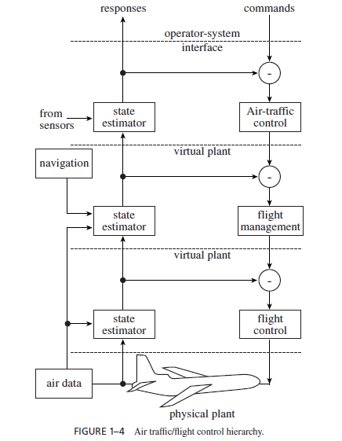

Slide 5
Guidance and Control
System must find the most desirable path among all given path that meet the constraints of system.
Optimal selection of path is used for optimization of cost of function. It is implemented by efficient algorithm.
One of the best eg. Is flight management system, in which we manage flight by ATC, important characteristics is to minimize cost function.
It can be done by dynamic programming implemented with help of mathematical programming guidance.

Slide 6
System does not need to compute its control law computation frequently. This computation can be done offline when precomputed flight plan is updated or new one.

Slide 7
Real time Command and Control
Controller at highest level of control hierarchy is command and control system.
ATC is excellent example.
ATC system monitors aircraft in its coverage area and the environment (eg. Whether Condition) and generates the information needed by operator(Air traffic Controller)

Slide 8
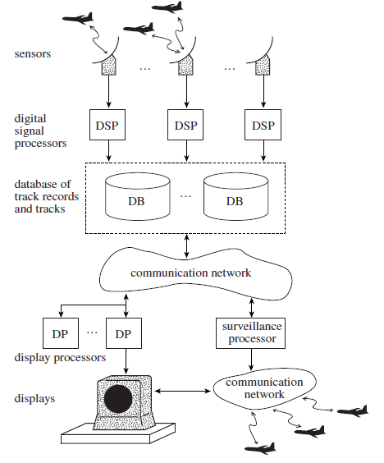

Slide 9
RADAR senses the object and relevant data is transferred to database through digital signal processor.
DB actually contain the track records i.e movement of objects in certain range with appropriate condition parameter such as height of aeroplane, weather condition, and DB records transferred to ATC through display procedure.

